Slide 1
Externship Conference Call May 13, 2020
4:00-5:00 pm
5:00 - 6:00 pm (MST)

Slide 2
STEM AC Staff on the Call - Introductions
Dr. Angela Hemingway - Executive Director
angela.hemingway@stem.idaho.gov
Stephanie Lee - Grants & Contracts Analyst
stephanie.lee@stem.idaho.gov
Crispin Gravatt - Data & Research Analyst
crispin.gravatt@stem.idaho.gov
John McFarlane - Partnerships/Externship Coordinator
partnerships@stem.idaho.gov

Slide 3
Externship Pilot Program Overview
Inclusive Dates: May 1st - September 7th
200 hours of work
Set up work schedule with site host
Subcontractor status

Slide 4
Paperwork
Contract and W9
Invoice Template
Proposed and Daily Work Schedules

Slide 5
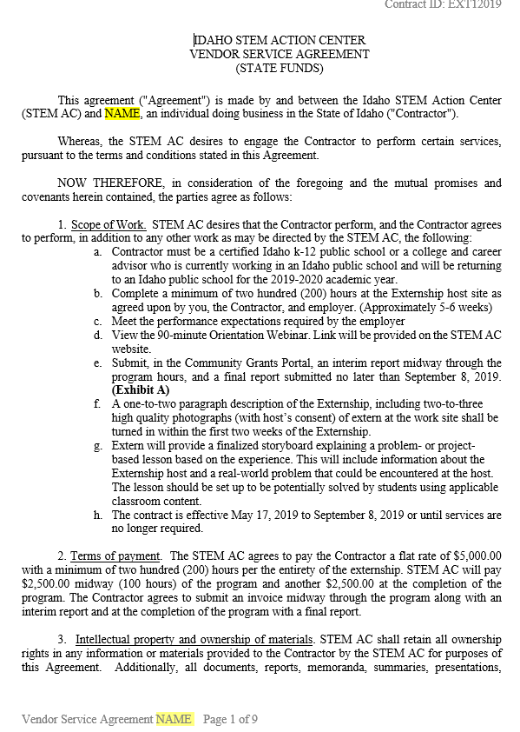
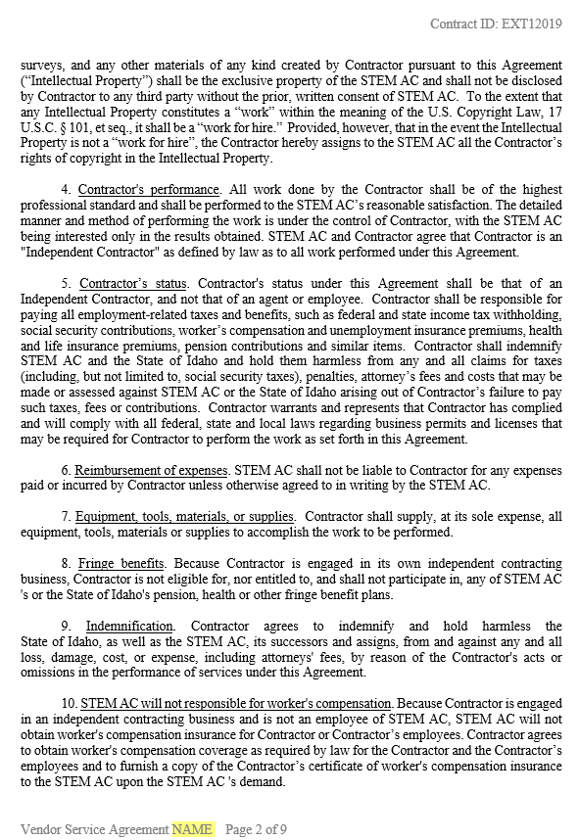
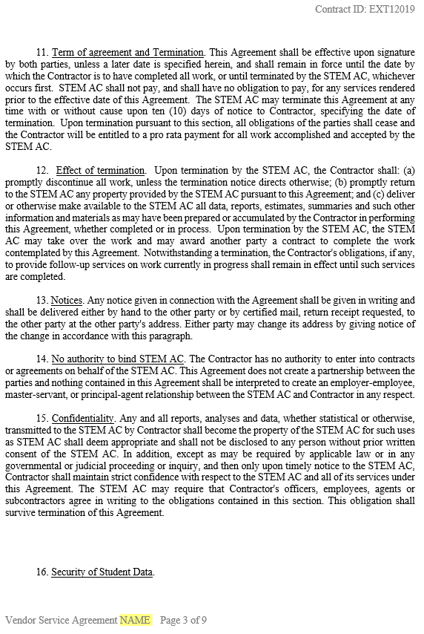
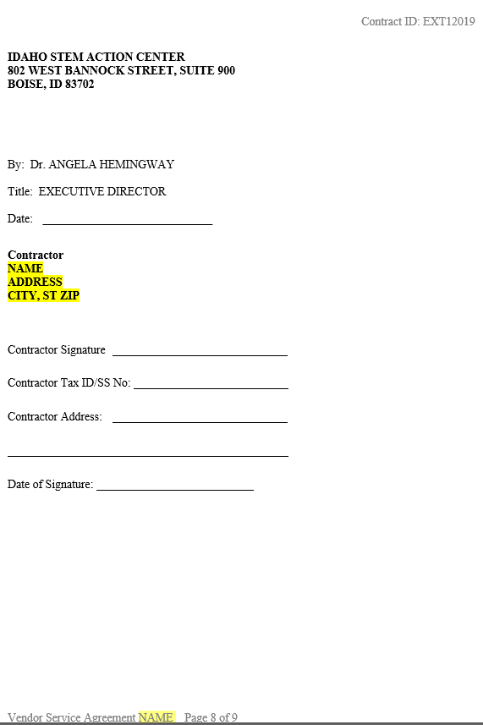
Contract & W9
Contract is between the STEM AC and you (independent contractor)
Below outlines a few of the sections within the contract (contract is 9 pages):
Scope of Work (SOW)
Terms of Payment
Contractors Performance
Reimbursement of Expenses
Term of agreement & Termination
Contractor will need to fill in the blank information here and return to Steph, stephanie.lee@stem.Idaho.gov, or fax 208-322-0306, before any work can be done.
*Steph will fill in the highlighted sections.

Slide 6
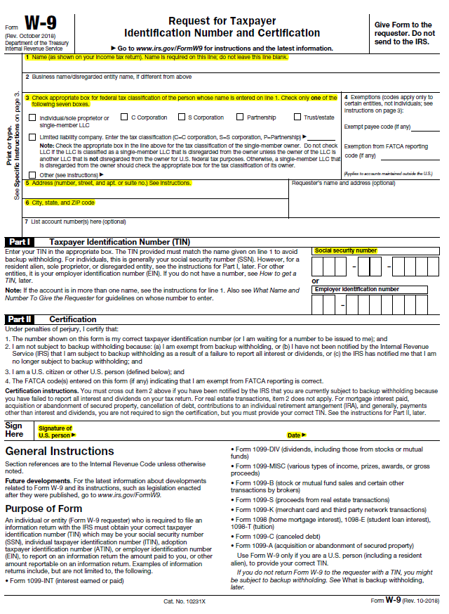
W9 Form
W9 is required for any person doing business with the State of Idaho.
Contractor MUST fill in each highlighted section, sign, and date. Return to Steph with your contract and liability waiver.
If you already have a W9 on file with the State of Idaho this is not needed.
Exception - any information has changed: name or address
W9 required before any payment will be made.

Slide 7
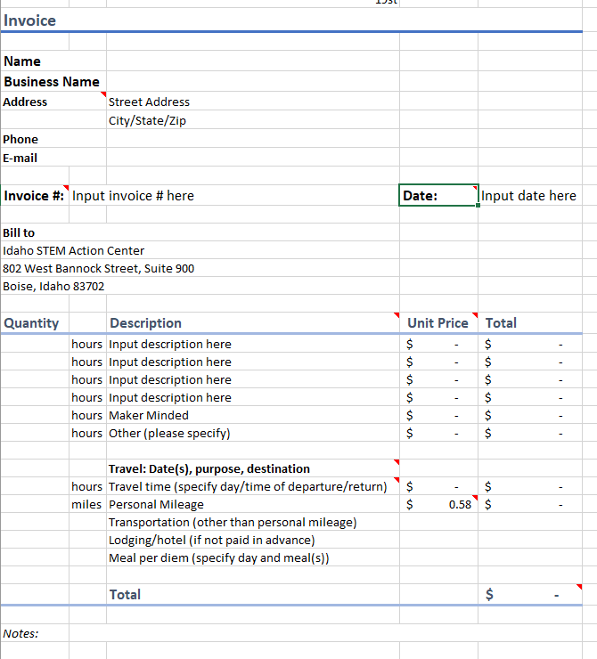
STEM AC Invoice Template
Invoices will need to be emailed to Sondra Chadd, Sondra.chadd@stem.Idaho.gov. Sondra oversees all invoices and billing for the STEM AC. Please contact her if you have questions regarding your invoice or payments.
You will submit 2 invoices. 1 midway (100 hours and interim report has been submitted) of the program and the 2nd upon completion of the program (200 hours and final report has been submitted)
Red triangles indicate instructions. Please contact Sondra Chadd with any questions regarding your invoice.

Slide 8
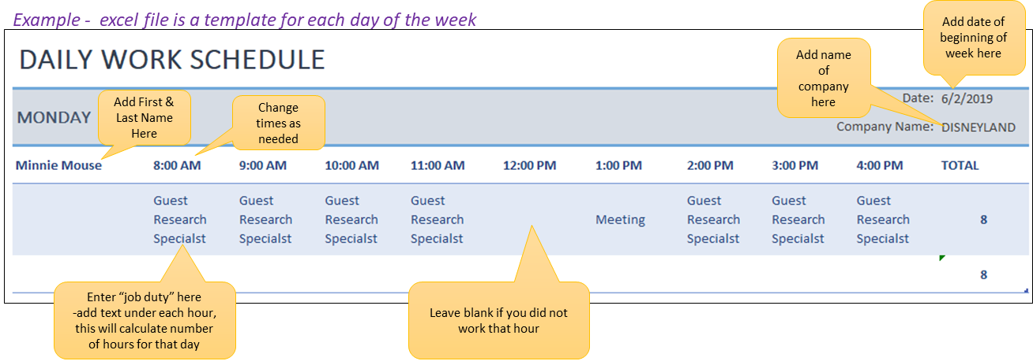
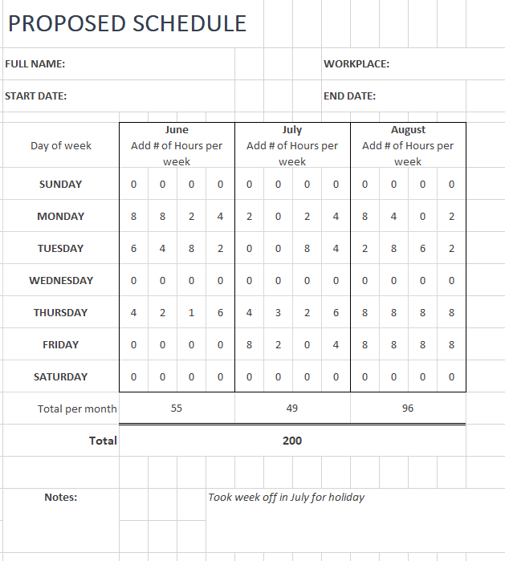
Proposed & Daily Work Schedule
Proposed Schedule:
Complete once, prior to starting externship, send to Steph, stephanie.lee@stem.Idaho.gov
Used to give STEM AC/WDC a timeline to schedule site visits.
Daily Work Schedule (required for interim and final reporting):
Complete once a week
Upload to the Community Grants Portal - Crispin Gravatt will review

Slide 9
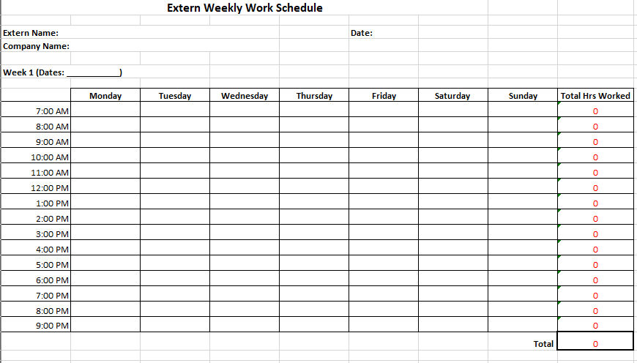
Proposed & Daily Work Schedule
Proposed Schedule:
Complete once, prior to starting externship, send to Steph, stephanie.lee@stem.Idaho.gov
Used to give STEM AC/WDC a timeline to schedule site visits.
Daily Work Schedule (required for interim and final reporting):
Complete once a week
Upload to the Community Grants Portal - Crispin Gravatt will review

Slide 10
Communicating with the Host Site
Anyone not had contact from your host site?
Please email John contact information for site mentor
Name
Email address
Work phone number

Slide 11
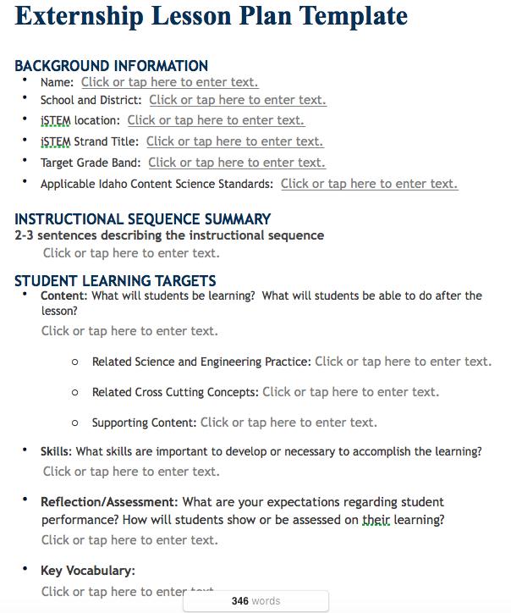
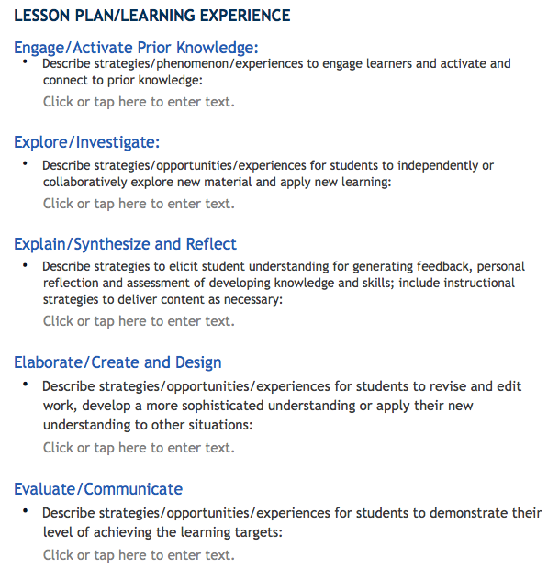
Connecting Your Experience to the Classroom

Slide 12
Requirements for all Externs
Journal structure
Interim Weekly Report: https://stem.idaho.gov/wp-content/uploads/2019/05/Externship-Interim-Weekly-Report-Template.pdf
On-the-job photo
Final Weekly Report: https://stem.idaho.gov/wp-content/uploads/2019/05/Externship-Final-Weekly-Report-Template.pdf
Report instructions: https://stem.idaho.gov/wp-content/uploads/2017/11/How-to-Submit-a-Report.pdf
Video: https://youtu.be/RZAqh7lA8yw

Slide 13
Additional Requirements for Credit
How many are planning to sign up for credit?
Lesson plans using template provided (included in Final Weekly Report)
Syllabus Link: https://stem.idaho.gov/wp-content/uploads/2020/04/Externships-Syllabus-2020_withLink.docx

Slide 14
STEM AC Contact
John McFarlane
partnerships@stem.idaho.gov
208-231-1466
At least one site visit over the summer

Slide 15
Questions?

