Slide 1
Cracking the Code
i-STEM Institute
Idaho State University
June 19-22, 2018

Slide 2
Tuesday
June 19, 2018

Slide 3
Schedule for the day
7:30 Check in and breakfast
8:00 Welcome and introductions- Scott Rasmussen
8:30 Introduction, Survey
9:15 Parts of a Computer
10:30 Break
10:45 Saving things on a computer
12:00 Lunch
1:00 Software and Networks
2:30 Typing
3:15 Keynote speaker Kevin Young
4:30 End of the Day Drawing
5:00 BBQ

Slide 4
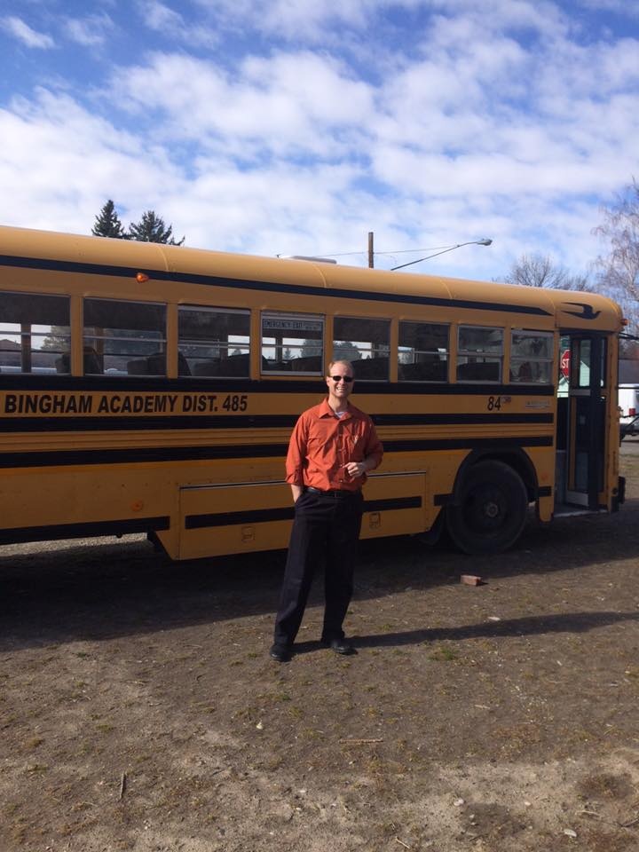
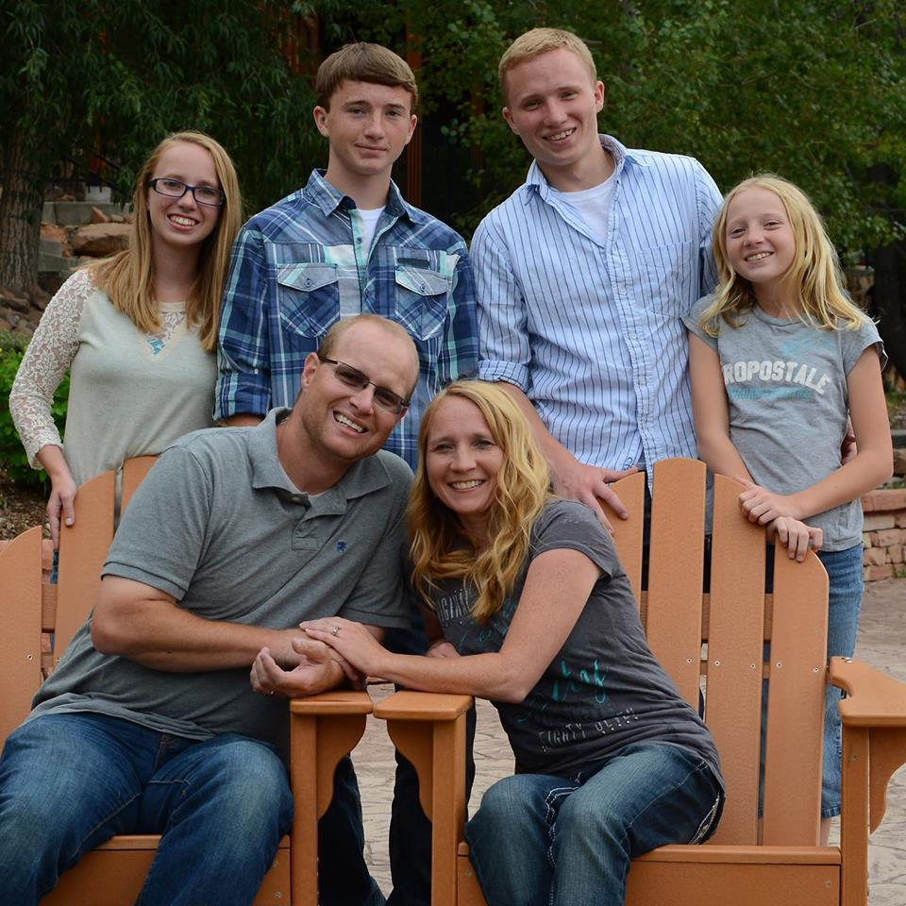
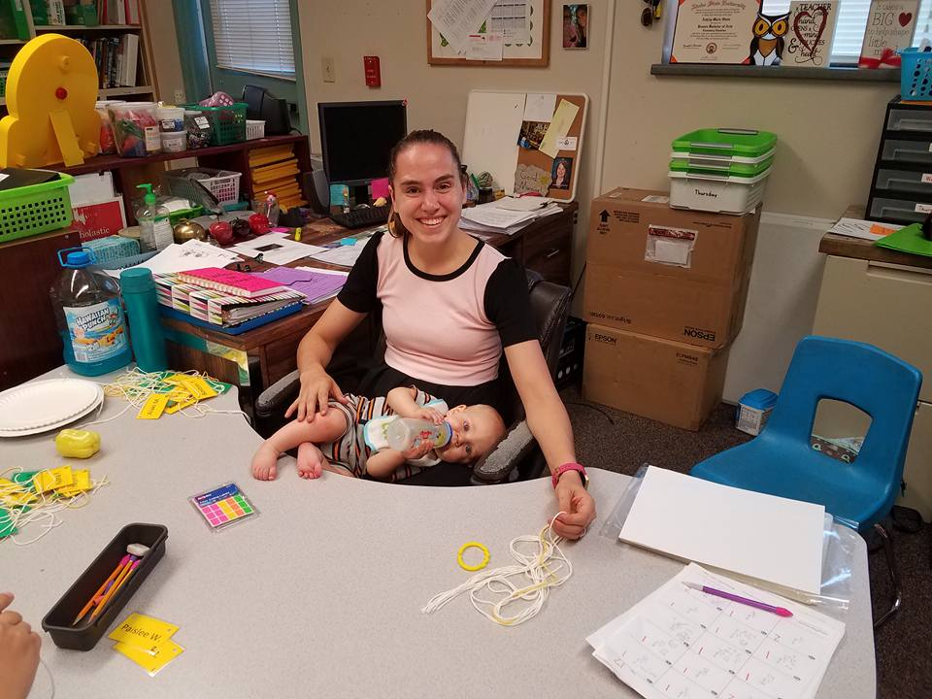

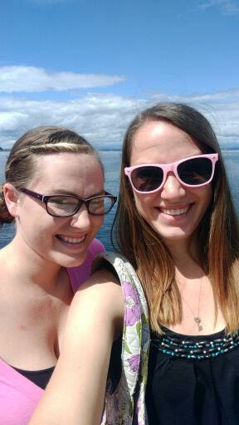
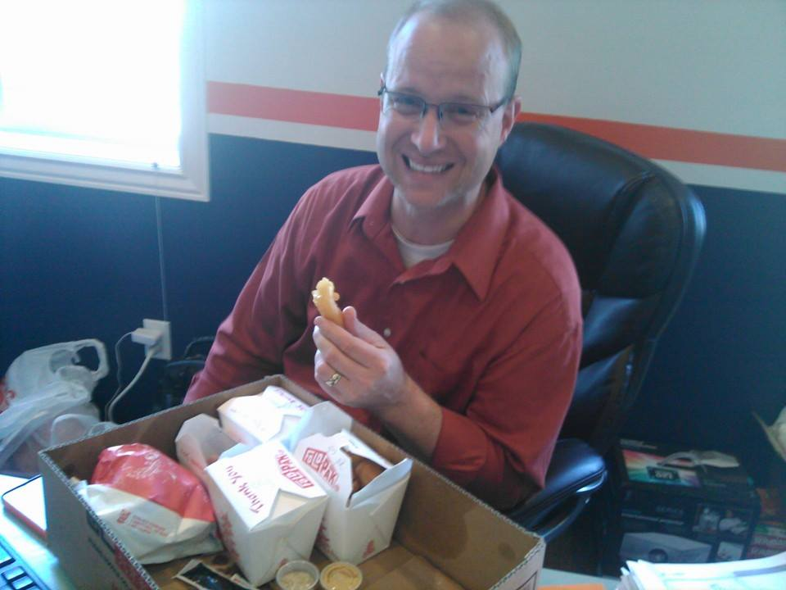
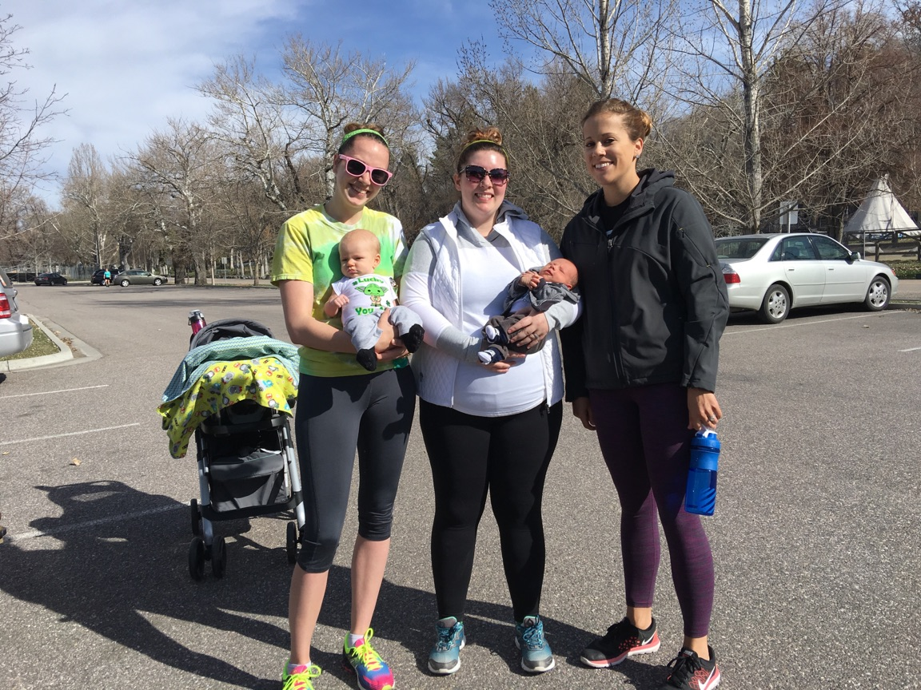
Who are We?

Slide 5
Contact Information
Ashley Schaffner
Chad Harris
Blackfoot Charter Community Learning Center
aschaffner@bcclc.com
208-760-7126
Blackfoot Charter Community Learning Center
Charris@bcclc.com

Slide 6
Survey
Cracking the Code survey
  https://www.surveymonkey.com/r/58TC3DN

Slide 7
Goals for this strand
Participants will gain confidence in teaching Coding and Computer Science to their students
Participants will understand the benefits of teaching coding and computer Sciences to their students
Participants will leave with tools, resources, and lessons that they can apply to their own classrooms

Slide 8
Presents!
Please leave kits here so that as we go through the lessons you can pull out and use your new toys as needed/wanted

Slide 9
Parts of a COmputer
K-2.CS.01
Locate and identify computing, input, and output devices in a variety of environments (e.g. desktop and laptop computers, tablets, mobile devices, monitors, keyboards, mouse, printers).

Slide 10
What is a Computer?
Desktops
Laptops
Tablets
Phones
Tv
Ipods
What Else?

Slide 11
BrainPop Jr. as a resource
Jr.brianpop.com
Username: istem2018
Password: istem2018
Our Subscription is good for 1 year

Slide 12
https://jr.brainpop.com/artsandtechnology/technology/partsofacomputer/

Slide 13
Labeling parts of a computer
Split into small groups (3-4 people per group)
Take the cards and attempt to properly label the tablet and one of your laptops.
When done, raise your hand and I will come check
Fill out worksheet with properly labeled parts of a computer and what they are used for
If you finish before other groups are done, discuss how this activity could be used in your own classroom
  We will discuss this whole group when everyone is done

Slide 14
Break time!
Take a short 10-15 minute break

Slide 15
Saving things on a COmputer
K-2.DA.01
Classify and sort information into useful order without a computer (e.g. sorting objects by various attributes).
K-2.DA.02
Demonstrate that computing devices save information as data that can be stored, searched, retrieved, modified, and deleted.

Slide 16
Sorting game- 15 mins
Split into small groups (3-4 people per group)
Take pictures and sort them into file folders
Label file folders based on how pictures are sorted

Slide 17
Reflection!
Write a reflection on what you have learned so far
When complete, wait! (I know a lot of you will want to save it right away, but be patient!)

Slide 18
Google DOcs
What Experience do you have with google docs?
How do I use google docs?
How to create a google doc
How do share a google doc

Slide 19
Popcorn SHare

Slide 20
Lunch
Meet Back here at 1

Slide 21
Software and Networks
K-2.DA.03
Explain that networks, like the Internet, link people using computers and other computing devices allowing them to communicate, access, and share information.
K-2.CS.03
Recognize that software is required to control all computing devices (e.g. programs, browsers, websites, apps).

Slide 22
Look inside how computers work
Programs and SOftware
Review Computer Parts
Networks
What are some programs and Software that we know and use?
Lexia
Chrome
Microsoft word
  Screen/ Monitor
  Keyboard
  Mouse
  Trackpad
  CPU
  Headphones
  Printer
  What else?
You
Computer
Router
Gateway
Server
Internet

Slide 23
Network Telephone
One person will be the computer
One person will be the router
One person will be the gateway
One person will be the server
One person will be the internet
The teacher will ask the computer a question
The computer will ask the router
The router will ask the gateway
The gateway will ask the server
The server will ask the internet
The internet will tell the server the answer
The answer will work its way back to the teacher
Switch people and let different students be different parts until everyone has been at least one part of the network!

Slide 24
History of computers
For Grown ups and older students
  https://www.youtube.com/watch?v=O5nskjZ_GoI (Start at 2:26)
For the littles
  https://www.youtube.com/watch?v=k4oGI_dNaPc

Slide 25
Break time!
Take a 10-15 min break

Slide 26
Typing
Go to typing.com
Create a temporary login
Try the lessons first
Then check out some games!!
Improvements that have been made recently
How I use it with my kids

Slide 27
Typing.com
Walk through creating a teacher account and putting students in when you get your class lists for next year!

Slide 28
Wednesday
June 20, 2018

Slide 29
Schedule for the day
7:30 Breakfast
8:00 Speaker Sean McBride
9:00 Introduction to Coding
10:30 Break
10:45 Coding “unplugged”
12:00 Lunch
1:00 Kodable
1:50 Break
2:00 Codespark academy, code.org, Education City
3:15 Break
3:30 IMC tour/ library display
4:45 End of the Day Prize Drawing

Slide 30
Coding!
K-2.DA.01
Classify and sort information into useful order without a computer (e.g. sorting objects by various attributes).

Slide 31
(https://jr.brainpop.com/artsandtechnology/technology/computerprogramming/)

Slide 32
Coding each other
Make sure to use the agreed upon coding language we came up with
The “robot” will decide the task to be completed
The programmer will Code the Robot to complete that task
Don’t forget, the robot has to follow directions exactly as they were presented!

Slide 33
Break time
Take a short 10-15 min break

Slide 34
Coding “Unplugged”
https://www.teacherspayteachers.com/Product/Unplugged-Coding-All-Year-Bundle-2906609
Find a partner
1 partner will arrange map pieces on the honeybee coding map, starting with the honeybee and ending with the hive.
Place Honeycombs in between to create a path
Now the other partner will write the code on the recording sheet to get the Honeybee to the hive
The first partner will check the code
Then switch!
After this try to challenge each other
  Place flowers and make your partner collect pollen!
  Place enemies and have them sting their enemies!
  Place Rain clouds and make them dodge the rain!

Slide 35
Adjustments I make in my class
We do the first few all together
I set up the first paths and the partners work through the code together
Students write code on squares first

Slide 36
Puppy Programming
www.raft.net/raft-idea?isid=743
Split into 4 groups (3-4 people per group)
Then 2 groups will team up (so you have 2 groups working on one game set and 2 on the other)
1 group at each game set will work together to place the puppy at the starting point and the ball at the ending point
Then they will create a path using the corks as barriers
Next the 1st group will find the code cards and place them in order for the puppy to get to the ball
Finally the 2nd group will come over and follow the 1st group’s code to see if the puppy makes it
Then the groups will switch (the 2nd group will code and the 1st group will check)

Slide 37
Coding Moby
Follow the direction on the Brainpopjr. worksheet
We will discuss when everyone is finished

Slide 38
Lunch
Meet back here at 1

Slide 39
Kodable
Go to kodable.com
Click student sign in
Click enter class code
Class code: istem
Find your name
Click on Blast off
Then Click on Smeeborg or click on Play
Have Fun!

Slide 40
Kodable Teacher Account
Let’s work together to create a teacher account that you can use in your classroom next year!

Slide 41
Break Time
Take a 10-15 min break

Slide 42
Codespark Academy-The Foos!
https://codespark.com/webgl/
Play through some of the levels
Think about how your kids would like this and how you could use it in your classroom

Slide 43
Code.org
Together we will explore code.org
After we explore together, take a little bit of time to dig in on your own and see what you can find that you think your students might like

Slide 44
Education city
Us.educationcity.com
Click Login
Enter Username and Password
Click on Computing
Click on 1st grade
Click on Activities
Click on Sea Drive
Then Click Play!

Slide 45
Reminders for Tomorrow
Make sure to bring your ID and your laptop
We won’t need your Laptop until the afternoon but please make sure you bring it

Slide 46
Thursday
June 21, 2018

Slide 47
Schedule for the day
8:00 Breakfast
9:45 Check-in at ON Semiconductor
10:00 Tour of Water Fab
11:00 Panel Discussion with engineers/ lunch
1:15 Debrief back at ISU
1:30 Prep for Friday’s Lesson
1:45 Break
2:00 Computational thinking and computer science careers
3:30 break
3:45 Speaker Kaitlin Maguire
4:45 End of the Day prize drawing

Slide 48
Programs to Download for lesson tomorrow
Google cardboard
Google expeditions

Slide 49
Computational Thinking and Computer Science Careers
K-2.IC.02
Understand that a wide range of jobs require knowledge or use of computer sciences.

Slide 50
Computational Thinking
https://jr.brainpop.com/artsandtechnology/technology/computationalthinking/
Matching activity
Why is computational thinking important??
https://www.youtube.com/watch?v=vOsdfRbrNdk

Slide 51
Computer Science Careers
https://www.rasmussen.edu/degrees/technology/blog/programming-careers-for-coding-connoisseurs/
1. Software application developer
2016 median salary: $100,080²
Required education: Bachelor’s degree
Projected growth (2016-2016): 30%
Software developers are responsible for creating and enhancing applications for cell phones, tablets and other mobile devices. This is a great career for someone who has a “big picture” mentality and likes to collaborate with others to bring ideas to life. Knowing coding basics and having an aptitude for math are also important.

Slide 52
2. Web developer
2016 median salary: $66,130²
Required education: Associate’s degree
Projected growth (2016-2026): 13%
How a website looks and functions is the direct result of a web developer’s work. All programming careers take patience, but this one provides more instant gratification than most. Web developers listen well to their clients’ needs and problem-solve to give them the best website possible for their business. At the end of a project, you have a working, accessible website to show off your hard work. Web developers do well when they can show a portfolio of their work and have a deep understanding of coding.
3. Database administrator
2016 median salary: $84,950²
Required education: Bachelor’s degree
Projected growth (2016-2026): 11%
Database administrators are tasked with securing, organizing or troubleshooting storage for large amounts of information for companies online. If you love analyzing and recovering information, as well as fast problem-solving, this could be a great career for you.

Slide 53
4. Computer network architect
2016 median salary: $101,210²
Education: Bachelor’s degree
Projected growth (2016-2026): 6%
Connecting multiple people within a company through one central system is the role of a computer systems architect. This architect solves company needs to communicate by upgrading a system or troubleshooting it using code. Evaluating the technology and putting together a company analysis report is also part of the job.
5. Computer systems analyst
2016 median salary: $87,220²
Education required: Bachelor’s degree
Projected growth (2016-2026): 9%
The strategist behind the computer systems architect is the computer systems analyst. The analyst works on behalf of the corporation with the computer network system to see which upgrades would be worth the financial cost to make their online communication more efficient. Once an analyst convinces a company to upgrade their system, coding is analyzed for errors and corrected.

Slide 54
6. Software quality assurance (QA) engineer
2016 median salary: $86,510²
Education requirements: Bachelor’s degree
Projected growth (2016-2026): 9%
Software QA engineers are at the beginning of software, documenting defects, designing tests and scenarios and creating manuals for new software. They also review software designs for functionality and potential problems.
7. Business intelligence analyst
2016 median salary: $86,510²
Education requirements: Bachelor’s degree
Projected growth (2016-2026): 9%
Programming is a bonus, but not as much of a necessity for the business intelligence analyst. This position is for the behind-the-scenes marketer who gathers all the cold facts about software products and trends to determine which software can help solve business initiatives.

Slide 55
8. Network system administrator
2016 median salary: $79,700²
Education requirements: Bachelor’s degree
Projected growth (2016-2026): 6%
Network system administrators maintain computing environments in their networks and prevent disasters by backing up data. Providing network security and avoiding viruses are the major tasks, along with making sure codes are free of errors and protecting both the network and hardware of the computers.
9. Computer programmer
2016 median salary: $79,840²
Education requirements: Bachelor’s degree
Projected growth (2016-2026): -2%
Computer programmers write programs and rewrite programs until they are free of errors. They use a workflow chart and coding formulas until the desired information is produced. Attention to detail and patience set you apart in this career.

Slide 56
What Else????

Slide 57
How do we help under represented populations access these careers?
Teaching coding in our classrooms
Providing activities that reach the children where they are
STEM Action Center Mentorship portal
What else?

Slide 58
https://www.youtube.com/playlist?list=PLP7Bvyb3ap476Vup0ycZhAt3Eo9AG2pQY

Slide 59
Friday
June 22, 2018

Slide 60
Schedule for the day
7:30 Breakfast
8:00 Speaker Crispin Gravatt
9:00 Review
9:15 Code-a-pillars
10:15 break
10:30 Digital Citizenship
12:00 Lunch
1:00 Virtual Reality
2:00 Prep for strand share out
2:15 Final surveys
3:00 break
3:15 Strand Share
4:30 Wrap up

Slide 61
Review
Parts of a computer
Saving things on a computer
Software
Networks
History
Typing
Coding
Computational Thinking
Computer science careers

Slide 62
Code-A-Pillars
Pull out your code-a-pillars and play with them for a few minutes

Slide 63
Code-A-Pillar challenges
Partner up and work together to complete the following challenges
Have the code-a-pillar get from point a to point b
Make the code-a-pillar turn at least 90 degrees
Make the code-a-pillar go around a chair
Have the code-a-pillar go under a “tunnel”
Make the code-a-pillar do at least 6 pieces of code
Have the code-a-pillar sing twice
Figure out how many “straight” pieces of code you would need to get the code-a-pillar across the room

Slide 64
Break time!
Take a 10-15 min break

Slide 65
Digital Citizenship
K-2.IC.01
Practice responsible digital citizenship (legal and ethical behaviors) in the use of technology systems and software.

Slide 66
Digital Citizenship videos
https://www.youtube.com/watch?v=uwY6KsipuJQ&list=PL8TjVyuBdsCnTZiAYcQcF4v-6dw0nlRJm
https://www.youtube.com/watch?v=8rOnMl26dR8&index=5&list=PL8TjVyuBdsCnTZiAYcQcF4v-6dw0nlRJm
https://www.youtube.com/watch?v=S7A2n1c3UiA&index=7&list=PL8TjVyuBdsCnTZiAYcQcF4v-6dw0nlRJm

Slide 67
Lunch
Meet back here at 1

Slide 68
Virtual Reality

Slide 69
Strand Share-Out
What did you learn?
What did you like?
Who is willing to share in front of everyone?

Slide 70
Final Surveys
Cracking the Code Survey
  https://www.surveymonkey.com/r/5L7VC96
STEM Action Center Survey
  https://idahostem.force.com/gms/

